Slide 1
www.MINEPORTAL.in
ONLINE TEST SERIES FOR
DGMS COAL/METAL FIRST/SECOND CLASS EXAM
GATE MINING EXAM
OVERMAN EXAM TEST
MINING INSPECTOR EXAMS
COAL INDIA MTs & OTHER PSUs EXAMS
FREE STUDY MATERIAL & VIDEO LECTURES
MINING JOBS NOTIFICATIONS
www.mineportal.in Call/Whatsapp-8804777500 www.fb.com/mineportal.in

Slide 2
MECHANICAL BRAKING SYSTEM OF MINE WINDERS

Slide 3
WHAT IS A BRAKE ?
Brake is a safety device which inhibits motion.
Braking is the conversion of kinetic energy into other forms of energy.

Slide 4
Purpose of braking(in winders):
Stopping the cage at various insets
Holding the cage at rest at a desired location
Speed control of hoists( affect retardation)
Emergency stoppage of cage for safe hoisting
Controlled slipping function

Slide 5
Classification of braking system:
MECHANICAL BRAKING SYSTEM: It dissipates all the kinetic energy of the system by means of frictional forces to the atmosphere in the form of heat.
ELECTRICAL BRAKING SYSTEM : It converts kinetic energy of a moving or rotating body into electrical energy which can be stored in batteries or lost in the form of heat.

Slide 6
MECHANICAL BRAKING METHODS:
Although due to the universal application of electrical braking systems like regenerative braking and dynamic braking the use of mechanical braking systems for normal service has reduced .
However the regulations demand that all brakes should “FAIL TO SAFETY”.
Electrical systems are liable to failure in operation due to minor or major circuital defects or on the event of power failure.

Slide 7
MECHANICAL BRAKING METHODS:
Hence the role of mechanical braking system as a critically reliable safety device comes into play.
It is always the case that electrical braking systems are used in conjunction with mechanical braking units , their operations interlinked.

Slide 8
Purpose of mechanical braking:
THREE PRIME FUNCTIONS:
Service braking involves the retarding or restraining of the speed as required by the operator or by the automatic controls and to bring the conveyance to rest.
Parking braking involves holding the load safely when the wind is completed, or when power is disconnected for servicing or standing idle.

Slide 9
Purpose of mechanical braking:
Emergency braking results in automatic slowing(retardation) and stopping the winder before the conveyance or skip reaches the limits of travel without assistance from an external source of energy. It shall occur when:
(a) The controls malfunction or control is lost;
(b) Power is lost;
(c) An emergency stop is instigated by either personnel intervention or some protective device signalling an operating fault.
(d) drop in pressure of actuating hydraulic fluid
(e) Excessive speed of the conveyance indicated by an electronic over-speed limiter.

Slide 10
Purpose of mechanical braking:
Service brakes and Parking brakes are instigated by the same braking circuit while Emergency braking has a totally independent operational circuit so that it can be applied irrespective of the operation of service braking.

Slide 11
Types of mechanical brakes:
Pivoted Brakes: These are the conventional brakes which actuate levers connected to the brake shoe frame through an adjustable tension or tie rod.
Non-Pivoted Brakes: These have no levers or rods like the thruster type unit and disc brakes.

Slide 12
Design requirements of mechanical brakes:
The design requirements of hoist brakes are:
Smooth , precise , reliable and fast in operation under all loading conditions.
Low inertia of moving parts and minimum movement of brake shoes to eliminate shock loads when rapidly applied.
Quick and simple means of adjusting the clearance of brake lining.
Force of braking should be readily adjustable.
Accurate and consistent performance over a long period.
Negligible internal friction.

Slide 13
Design requirements of mechanical brakes:
Consistent rate of deceleration anywhere in the shaft.
Even wear of the brake lining.
Good dissipation of heat to ensure cooling of brake shoes.
Minimum linkages , freedom from slackness due to wear of pins and joints, no bending and stretch of components, elimination of ‘SINGLE-LINE’ components.
Pivots fitted with non metallic brushes to eliminate need of lubrication

Slide 14
Design requirements of mechanical brakes:
No tendency to vibrate.
In case of emergency the cage should decelerate to stop in the minimum possible distance without harming men and preventing over-stress of conveyance attachments.
Permissible accomodation for axial movement of host drum in their bearings.
Simple and compatible design so that it can be readily tested for duty with safety.
Easy to install and dismantle for inspection and maintainance.

Slide 15
Design requirements of mechanical brakes:
In hydraulic and compressed air controls , failure of system pressure should cause full application of brakes.
Even in the event of malfunctioning of mechanical braking system, it should provide atleast 50% of the normal braking torque.
Safe stoppage of hoist at speeds 15% more than the rated full speed.
All components should fail to safety.
Manufactured upto a satisfactory standard.
Atleast 2 independent braking systems when men are transported

Slide 16
Design requirements of mechanical brakes:
Meet the statutory requirements regarding factor of safety with maximum out of balance load held and the minimum and maximum deceleration rates for the brakes.
Means of automatic indicators of brake operation.

Slide 17
Different Designs for Pivoted Brakes:
Anchored Post Brake with Top Tie Rod
Anchored Post Brake with Side Tie Rod
Suspended Post Brake
Parallel Motion Brake
Caliper Brake

Slide 18
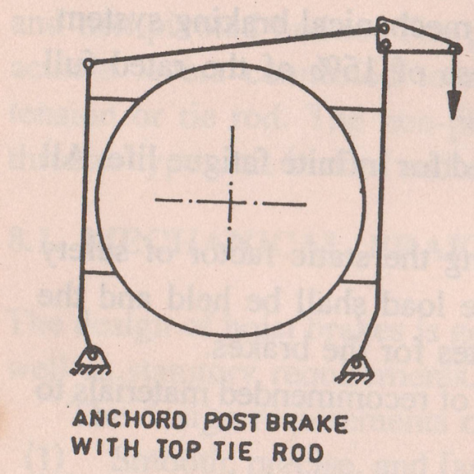
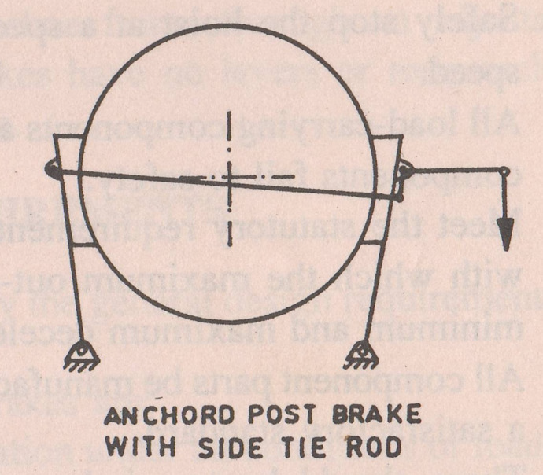
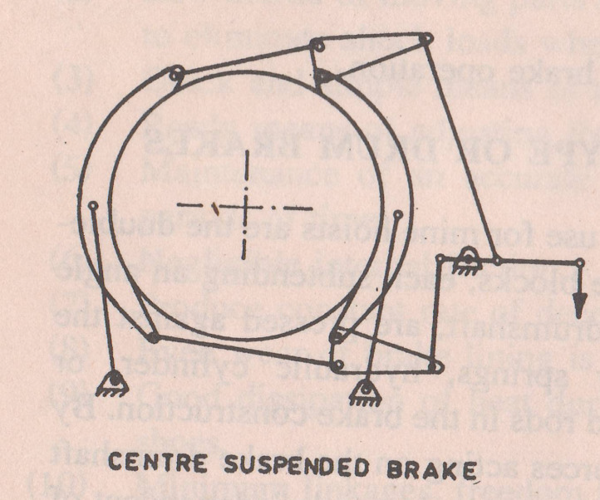
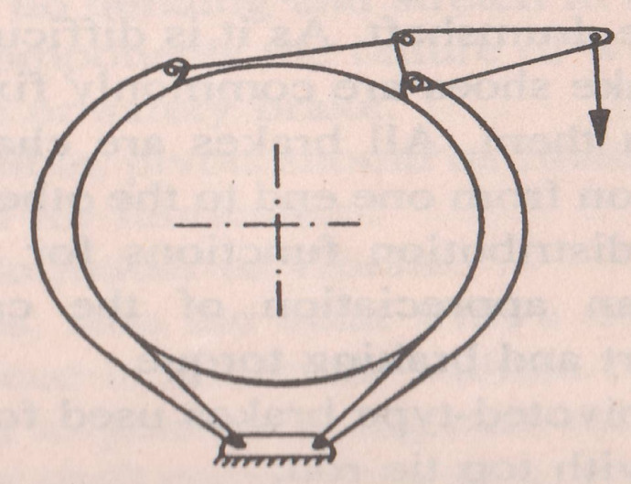
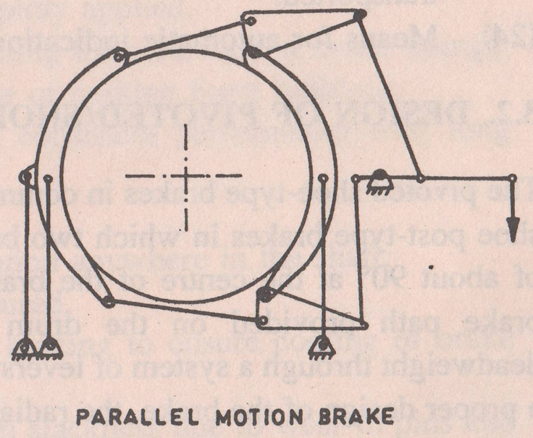

Slide 19
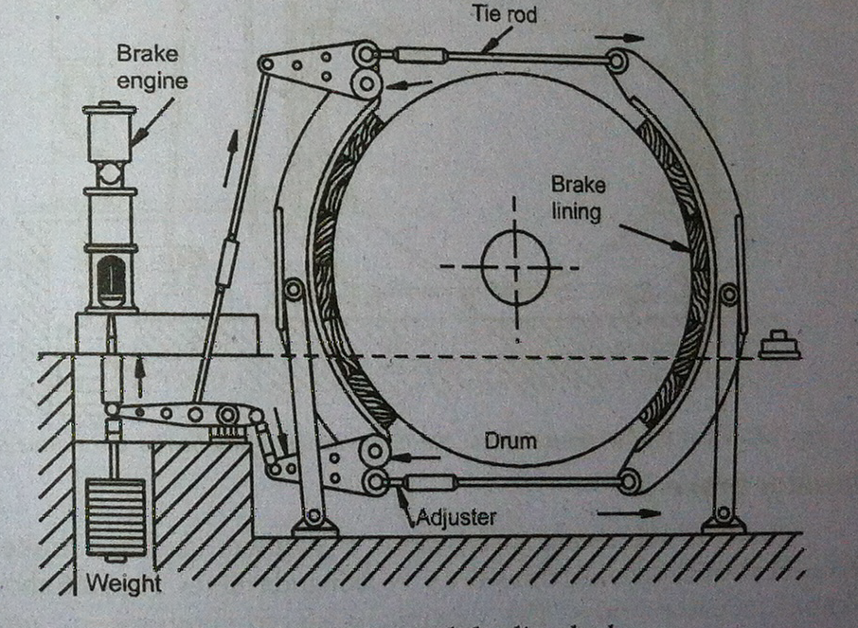
Working of Pivoted Brakes:

Slide 20
Working of Pivoted Brakes:
There are Brake shoes or blocks which are lined with bonded asbestos or fibre like “Ferrodo” brake lining.
The coefficient of friction should be such that it takes into consideration the decrease in its value due to presence of oil and water on the brake path.So, it is maintained nearly 0.4 .
The brakes are ‘ON’ Type i.e. They hold the drum when stationary and when it is not required to be rotated with the help of dead weights suspended from the brake levers.

Slide 21
Working of Pivoted Brakes:
An adjuster on the tie rod is used to adjust the position of the brake blocks relative to the drum as the brake lining wears in due course of time.
The dead weight is lifted by a brake engine operated by steam, oil pressure or compressed air with the help of a system of rods.
The control valve is designed such that in case the supply of steam , oil or air fails then the brake is automatically applied by the falling weight.

Slide 22
BRAKE OPERATING SYSTEMS:
Salient Features of an Ideal operating System:
It should assure fast, sensitive and precise control of the braking effort.
The hoist operator should be able to perform braking operations under all conditions easily by small movements of the brake lever with maximum safety.
It should provide easy switching from manual to automatic operation.

Slide 23
TYPES OF BRAKE CONTROL SYSTEMS:
The various types of brake operating and control systems are:-
Weight-applied and Pressure(air or oil)-released
Fluid pressure-applied and Fluid pressure-released
Spring-applied and Fluid pressure-released

Slide 24
COMPRESSED-AIR OPERATED BRAKES:
Single Axis Brakes:-
consists of a pair of vertical cylinders of same or different diameters mounted on a common centre line.
Upper-service cylinder, lower- holding cylinder
To actuate braking, through a linkwork the ‘brake pressure regulator’ is operated which causes compressed air to fill the service cylinder.
The piston rises causing brake shoe to exert pressure on the brake paths.
The dead weight does not move as holding cylinder is filled with air during service braking.

Slide 25
COMPRESSED-AIR OPERATED BRAKES:
In case of emergency the line air immediately enters the service cylinder via the regulator while the air in the holding cylinder is evacuated by the throttle valve .
Hence the piston of the holding cylinder moves quickly upwards to press against the piston of the service cylinder, thereby causing the brake shoes to exert pressure on the brake paths.
Braking takes place.

Slide 26
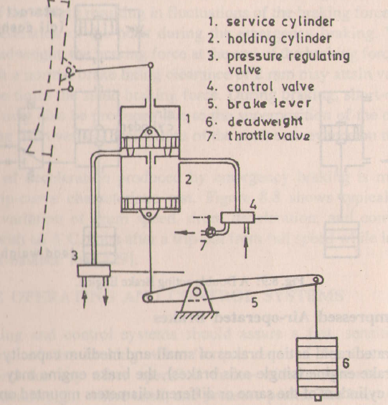

Slide 27
COMPRESSED-AIR OPERATED BRAKES:
Double-Axis Brakes:-
There are 2 cylinders for service and emergency braking.
A differential lever connects through a pressure rod, and pistons of service and holding cylinders.
During service braking the bell is pushed up by the compressed air,the differential lever turning about the pin connecting it to the piston of holding cylinder.
In case of emergency , air at maximum permissible pressure is forced in to the service cylinder so that braking effort is applied rapidly in a short time interval and short travel of the service piston while the air in the holding piston is evacuated by the throttle valve.

Slide 28
COMPRESSED-AIR OPERATED BRAKES:
Then the differential lever begins to turn about the pin connecting it to the pressure rod , lowering the bell to its seat as the deadweight begins to apply the braking effort.
Used in high capacity hoists and is more compact than single axis brakes.

Slide 29
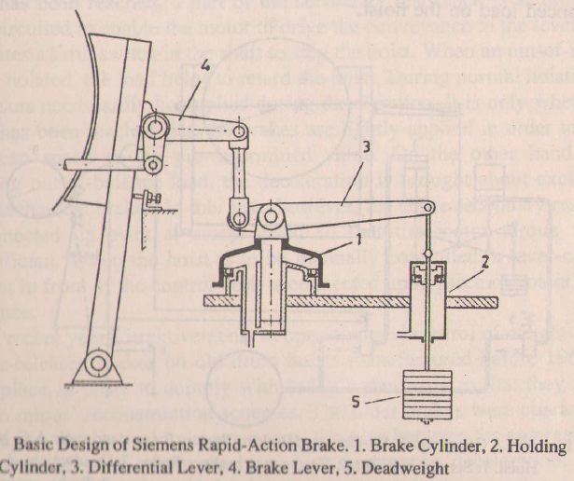

Slide 30
Advantages of Air-operated Brakes:
The supply of air is unlimited, so the brake system can never run out of its operating fluid, as hydraulic brakes can. Minor leaks do not result in brake failures.
Air line couplings are easier to attach and detach than hydraulic lines; there is no danger of letting air into the hydraulic fluid. So air brake circuits of trailers can be attached and removed easily by operators with no training.
Air not only serves as a fluid for transmission of force, but also stores potential energy. So it can serve to control the force applied .Air brake systems include an air tank that stores sufficient energy to stop the vehicle if the compressor fails.
Air brakes are effective even with considerable leakage, so an air brake system can be designed with sufficient "fail-safe" capacity to stop the vehicle safely even when leaking.

Slide 31
HYDRAULIC BRAKES:
Reasons for their popularity over air operated brakes:-
Difficulty to maintain compressed air pressure, requirement of clean and dry air.
Compressibility of air leads to slow brake operation
Hydraulic brakes require only electric current for operation
Instantaneous response and good control with high-pressure brakes.
The braking effort can be quickly and easily changed to suit the operating conditions

Slide 32
HYDRAULIC BRAKES:
Braking is smooth, accurate, reliable under all braking conditions.
No deadweight is necessary with spring power brakes
Hydraulic power pack is compact
Easy erection
Initial cost is less

Slide 33
HYDRAULIC BRAKES:
Depending on pressure of oil used, hydraulic brakes system are designed as:
low-pressure system (0.5-1.0 MPa)
medium-pressure system (10-21 MPa)
high-pressure system (24-27 MPa)
The volume of fluid to be moved, the dead time, reaction time and size of hydraulic components decreases with increase in oil pressure.
High pressure system have a high speed of operation with fast response and high accuracy of control.

Slide 34
Types of hydraulic brakes:
Shoe-type Hydraulic Brakes: These are generally
a. ”Fluid pressure applied and fluid pressure released” type with weight application in case of power failure
b. “Spring pressure applied” type, sometimes reinforced by weight for emergency application
Disc Brakes: They consists of multiple brake unit arranged to work on a brake disc fitted on one or both sides of the hoist drum.

Slide 35
Shoe-type Hydraulic Brake:
Fluid Pressure-Applied and Released Brakes:
Consists of a double acting service brake engine
Service engine is a 2 diameter cylinder with a 2 diameter differential piston with the larger diameter at the lower end.
Oil at constant pressure is supplied to the top of the cylinder while pressure in the bottom is controlled by a main brake valve and brake pressure regulator.
In the ‘off’ position, pressure on both side of cylinder is maintained same and since base is larger hence the piston is in lifted condition.

Slide 36
Shoe-type Hydraulic Brake:
In the ‘on’ condition , the main valve opens and exhausts the oil from below the piston which is forced down by the constant pressure above.
In the event of emergency trip, emergency solenoid is de-energised causing main valve to open there by applying the brakes in about 0.2 seconds.
An adjustable relief valve controls the working pressure of the hydraulic system.

Slide 37
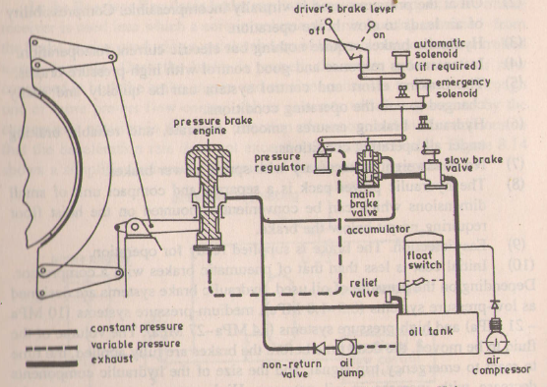

Slide 38
Shoe-type Hydraulic Brake:
Spring Power Brakes:
Suitable for automatic mode of hoist operation
Braking torque can be adjusted instantaneously
High pressure braking system have gained wider acceptance
If carefully designed, the brake will act as good manual as well as emergency brakes

Slide 39
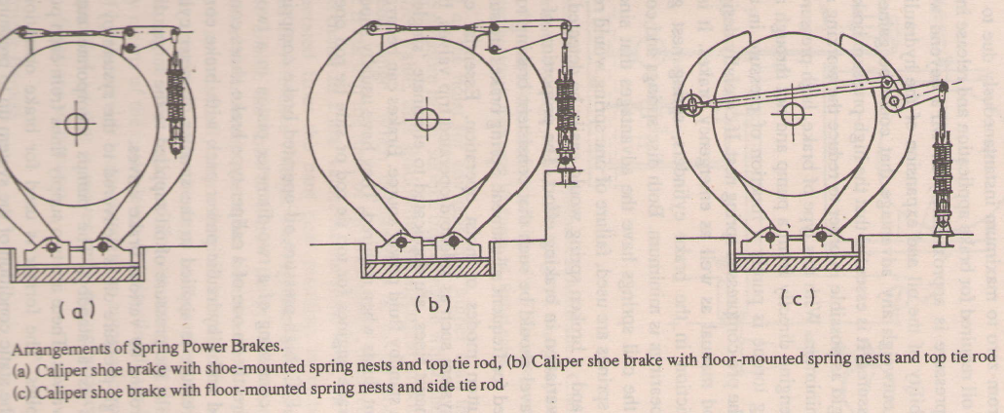

Slide 40
DISC BRAKES:
Increasingly used for friction hoist replacing the conventional drum brakes
They combine into a single unit- the hydraulically operated service brake and bellevelle spring operated emergency brakes.
A disc brake unit consist of 2 similar halves mounted on a yoke which in turn is mounted on a common frame.
To ensure that the brake lining is worn out uniformly, braking power is done over the entire area of contact uniformly.

Slide 41
DISC BRAKES:
Each brake half consists of a hydraulic brake cylinder with a piston and a powerful spring assembly with the no. of bellevelle to produce the braking pressure.
The brake pressure is transmitted on to a brake pad which presses against the friction disc to produce braking effect.
The spring force presses the brake shoe onto the friction disc.
During operation, a hydraulic oil pump pushes the oil into the braking unit at a pressure of around 16-24 Mpa.

Slide 42
DISC BRAKES:
The oil pressure overcomes the spring force to lift off the brake shoes.
The pressure of the oil is regulated by a pressure valve and the brake is operated by the use of a solenoid valve which energises and de-energises to control the flow of hydraulic liquid.
Energising -> pumping into the system, release of brake effort
De-energising-> liquid exhausted by pressure release, braking effort re-established
In case of a power failure, the solenoid de-energises causing the brakes to “fail to safety”.

Slide 43


Slide 44
DISC BRAKES:
Though disc brakes rely on the same basic principles to slow a vehicle (friction and heat), their design is far superior to that of drum brakes.
Instead of housing the major components within a metal drum, disc brakes use a slim rotor and small caliper to halt wheel movement. Within the caliper are two brake pads, one on each side of the rotor, that clamp together when the brake pedal is pressed.
Once again, fluid is used to transfer the movement of the brake pedal into the movement of the brake pads.
But unlike drum brakes, which allow heat to build up inside the drum during heavy braking, the rotor used in disc brakes is fully exposed to outside air. This exposure works to constantly cool the rotor, greatly reducing its tendency to overheat or cause fading.

Slide 45
DISC BRAKES:
The disc brake is designed to enable a large number of brake unit to be installed instead of fitting around the surface of the conventional drum brake ring, the new brakes grip on the either side of disc flanges mounted radically at the ends of the main drum right angle to it.
The brake units are extremely compact and thus a relatively large number can be installed on each disk flange.
The disc brake can be applied more rapidly than the conventional brakes and it is smoother in operation.

Slide 46
DISC BRAKES:
A very interesting feature of disc brakes is that the pads automatically adjust the clearance between the friction disc and the pads as they are worn out by regular use. As the shoes are worn out the fluid in the caliper hydraulic cylinder increases thereby maintaining a fixed clearance.
Hence drastic decrease in the level of oil in the tank is an indication that the brake shoes need replacement.

Slide 47
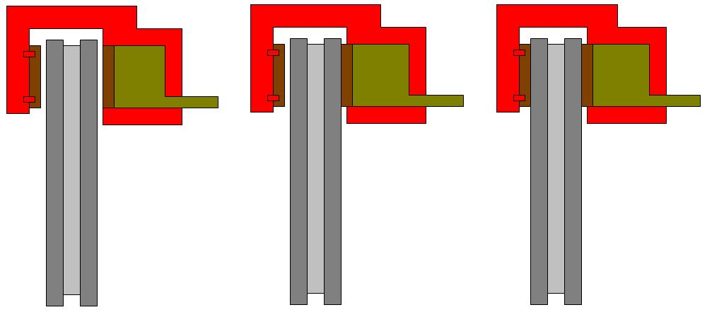
Caliper Operation:
Caliper
Brake
Fluid
1
Pads
2
3
Rotor
Step 1: Force is applied to by driver to the master cylinder
Step 2: Pressure from the master cylinder causes one brake pad to contact rotor
Step 3: The caliper then self-centers, causing second pad to contact rotor

Slide 48
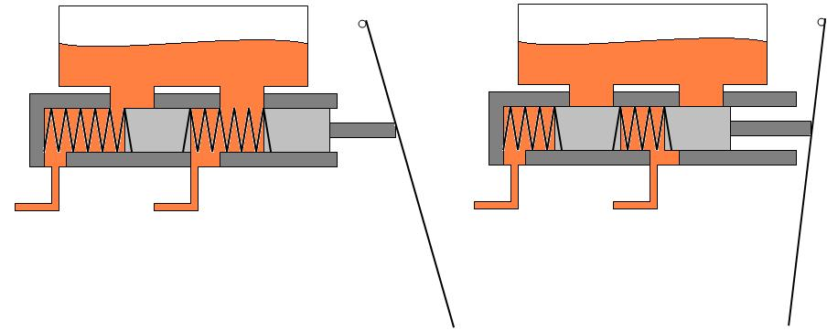
Master Cylinder:
Secondary
Primary
F_{applied}
Force is applied to brake pedal by driver
Primary piston moves, which in turn pressurizes fluid in front of the first piston. The secondary piston and primary piston are connected through a spring. As the primary piston moves, it causes the secondary piston to move and pressurize fluid in front of it.
The pressurized fluid in the brake lines then causes the brake pads to move into contact with the rotor.

Slide 49
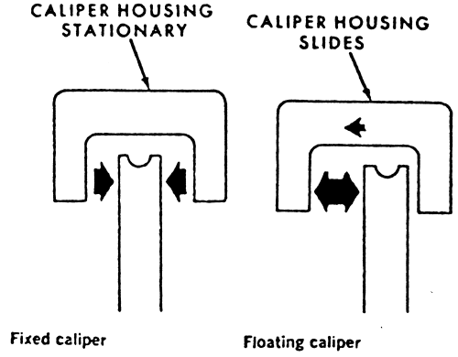
TYPES OF CALIPERS:

Slide 50
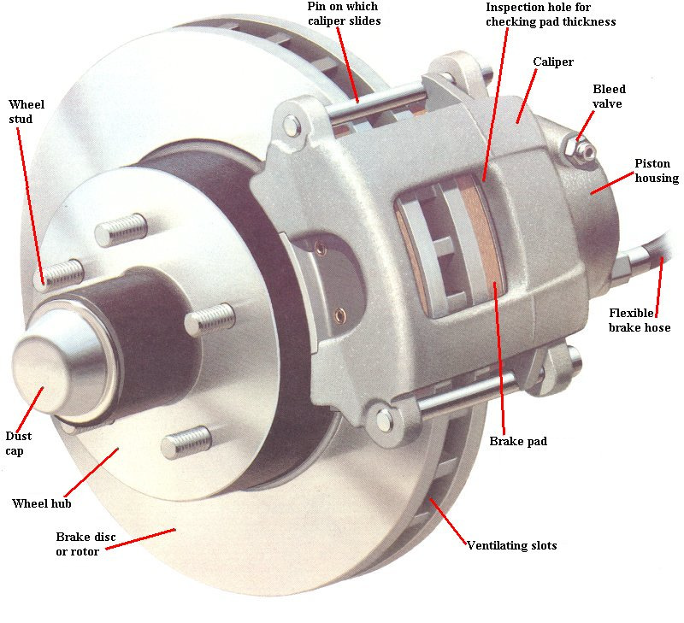

Slide 51
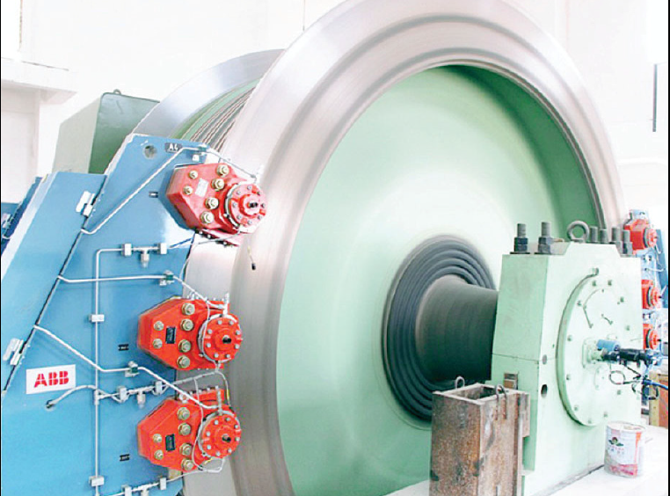

Slide 52
Advantages of Disc Brake over the conventional brakes:
Low inertia, fast response and extremely smooth and precise in operation.
High braking capacity, 2-3 times that of double shoe suspended brake of same diameter.
Easy to maintain and install with high reliability in service.
Apply equal braking in both direction of rotation.
Large cooling area since disc pad covering only small part of the disc.
Being compact, since mounted on hoist bed plate itself requires, less space.
Economical manufacture due to large number of units.

Slide 53
Coal Mines Regulations:
According to Coal Mine Regulation 2011:
There shall be provided one or more brakes on the drum or the drum-shaft.
At least one of the brake shall be so designed that the brake remains at the ON position except when operated.
Where the brakes are Power-operated at least one of them shall be arranged to be applied automatically at all times, if the power supply fails.
The brake on the drum shall be used only for the purpose of keeping the drum stationary and not for lowering the cage or any other means of conveyance.

Slide 54
THANK YOU

